Slide 1


PROJECT: Home on the Hill
Midterm Review – Endeavour Consulting
June 2, 2018
Paulina Abramowicz, Engagement Manager
Shahroz Ehsan, Senior Consultant
Neil Gangal, Consultant
Bruno Henderyckx, Consultant
Andy Lai, Consultant
Tyler Scott, Consultant
Julian Antony, Co-Advisor
Stuart Watts, Co-Advisor

Slide 2
Agenda
Client background and problems
Project goals and scope
Project milestones achieved
Key findings
Next steps and timeline
Issues encountered & wrap-up
Questions, feedback, suggestions

Slide 3





Client Background and Problems
Background on Home on the Hill (HOH)
Provide support to patients and families who experience serious mental illness
Established 2011, 6 board members, small, passionate, enthusiastic, primarily in Richmond Hill/Vaughan
Vision and Mission: Provide a caring home environment that projects a sense of belonging, growth and security for all persons, by changing the way people are supported (gaps/flaws in current health system)
Objectives and current services:
Patient activity/therapy through art, music, fitness, recreation, cooking, vocational training
Run weekly programs, 10 patients regularly attend
Family/caregiver support and respite
Hold bi-weekly support groups, 25 families supported
Develop more supportive housing
House one tenant on a part-time basis
Public education/outreach through Robert Veltheer Lecture Series on Mental Illness
Hold quarterly lectures by Psychiatrists, Doctors, Medical Writers, over 7,000 attendees
Problems
Changes to board, tied up with operations and funding applications, lack of planning/identity/strategy
Board members not aligned on mission/vision
Lack of short-term and long-term strategy
Concerns about
Efficiency/impact/attendance of support programs
Impact/attendance of lectures
Growth strategy to support long-term goal of providing supportive housing

Slide 4
Project Goals and Scope
Goals:
Current and future state assessment and gap analysis
To develop recommendations through the creation of a prioritization framework
To provide a realistic, agile and implementable strategic plan and roadmap
Scope:
Gap analysis
Needs assessment – community wide of the existing service delivery model
Capabilities assessment – skills required vs. skills acquired
Prioritization framework – what to focus on and in what timeframe
Competitive analysis
Recommendations with a high level timeline

Slide 5
Project Milestones Achieved
Robert Veltheer Lecture (April 24) data collection and analysis conducted
Handed out surveys to collect feedback
Held focus groups with members of the audience
Preliminary Client Survey set up:
Our planned N is >720 (online)
Mode of delivery – paper and online with financial remuneration
Questions structured collecting information in the following areas:
Survey participant details – age and occupation
Relationship to Home on the Hill
Priority of programs in what they depend on from Home on the Hill
Commuting time (and obstacles encountered) to getting to Home on the Hill
Ideas for providing better supports
Home on the Hill differentiation factors
What’s most meaningful as a service and what’s missing?
Recommendations and why
Financial analysis conducted
Internal desk review of incoming data - ongoing
Internal schedule of activities created
Internal timeline and milestones created

Slide 6
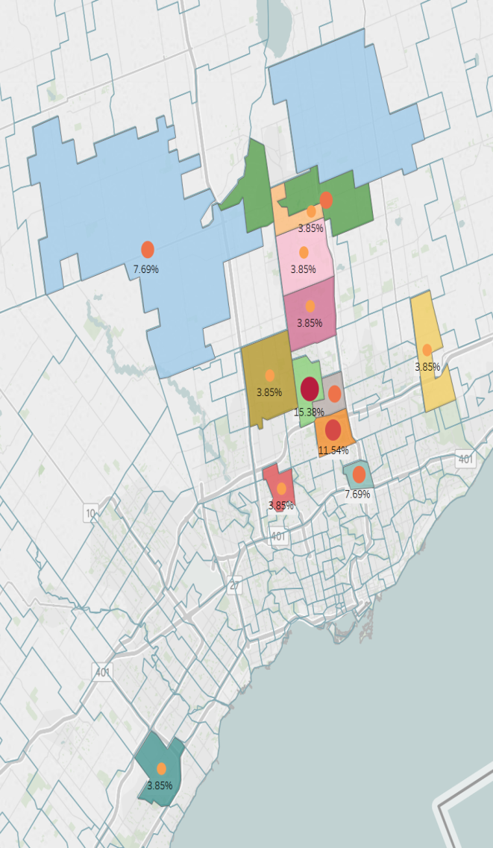
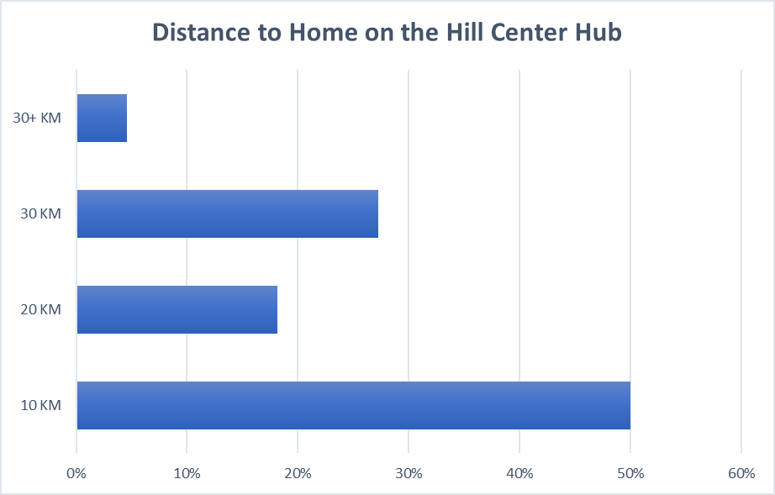
Key Findings – Where are Home on the Hill’s clients coming from?
Collected data from Veltheer Lecture
26 Data Points from Survey
Boundary (North Toronto, East Toronto, Yonge, Newmarket)
HOH
Family Member

Slide 7
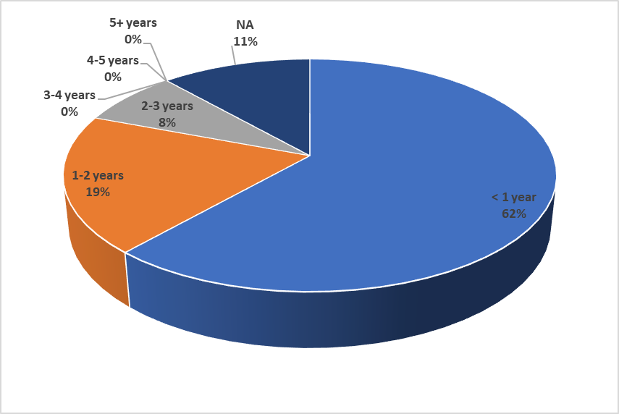
Key Findings – Awareness about Home on the Hill
Collected data from Veltheer Lecture
26 Data Points from Survey
NA – High potential 1st time clients
~75% are new to HOH

Slide 8
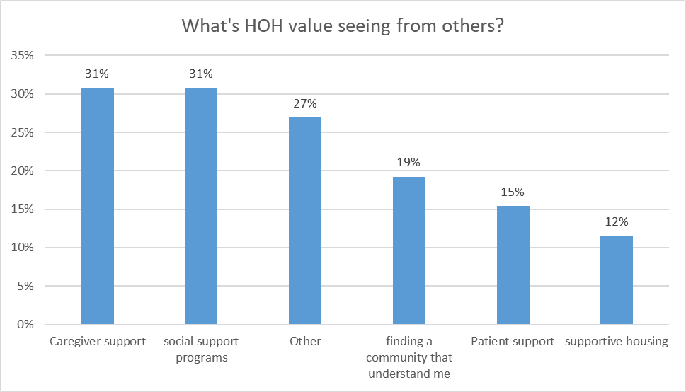
Key Findings – Perceived Value of Home on the Hill Services
Collected data from Veltheer Lecture
26 Data Points from Survey
Can choose multiple option
High value on Caregiver Support and Social Support Program
Education / Information Gathering

Slide 9
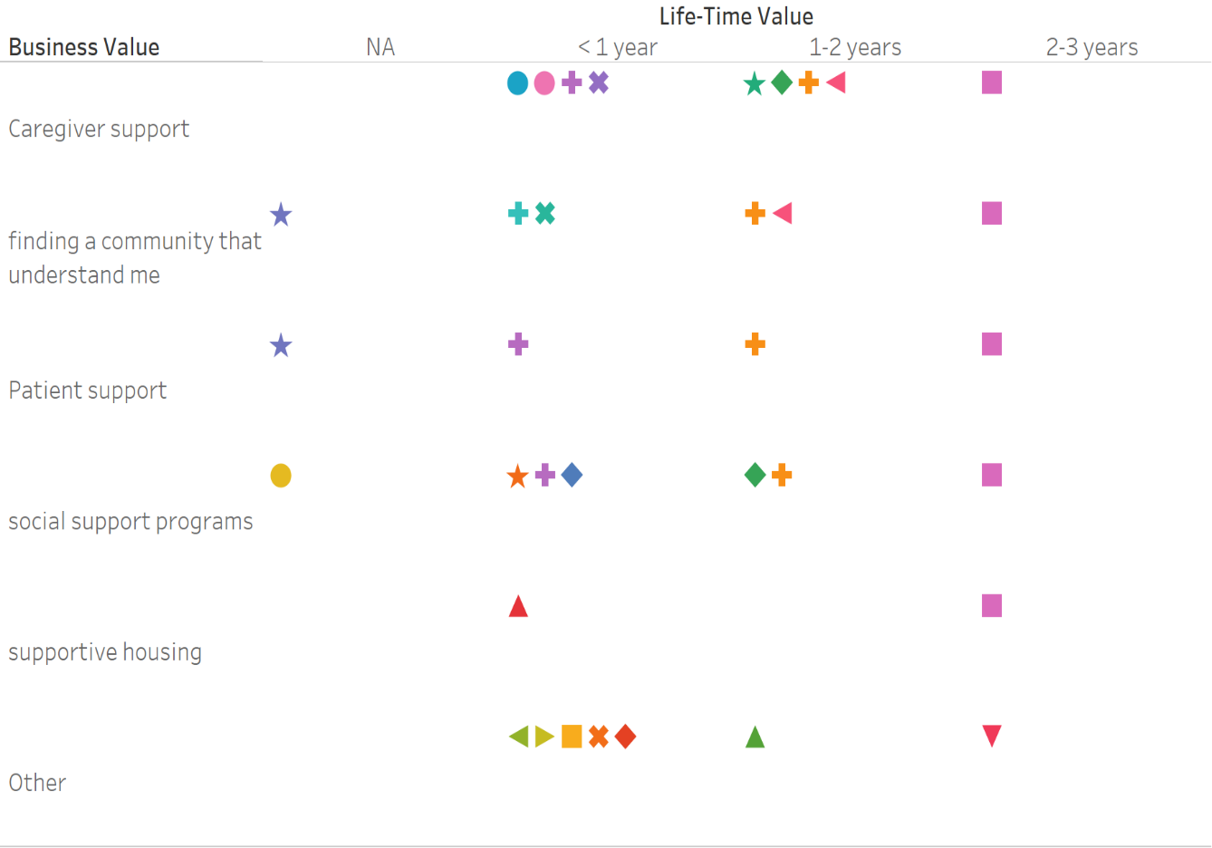
Key Findings – Perceived Value Based on Length of Awareness of HOH
Longer to stay at HOH, see more organization value
Others are highly rated by new members (General Education)
HOH did the best in Caregiver support

Slide 10
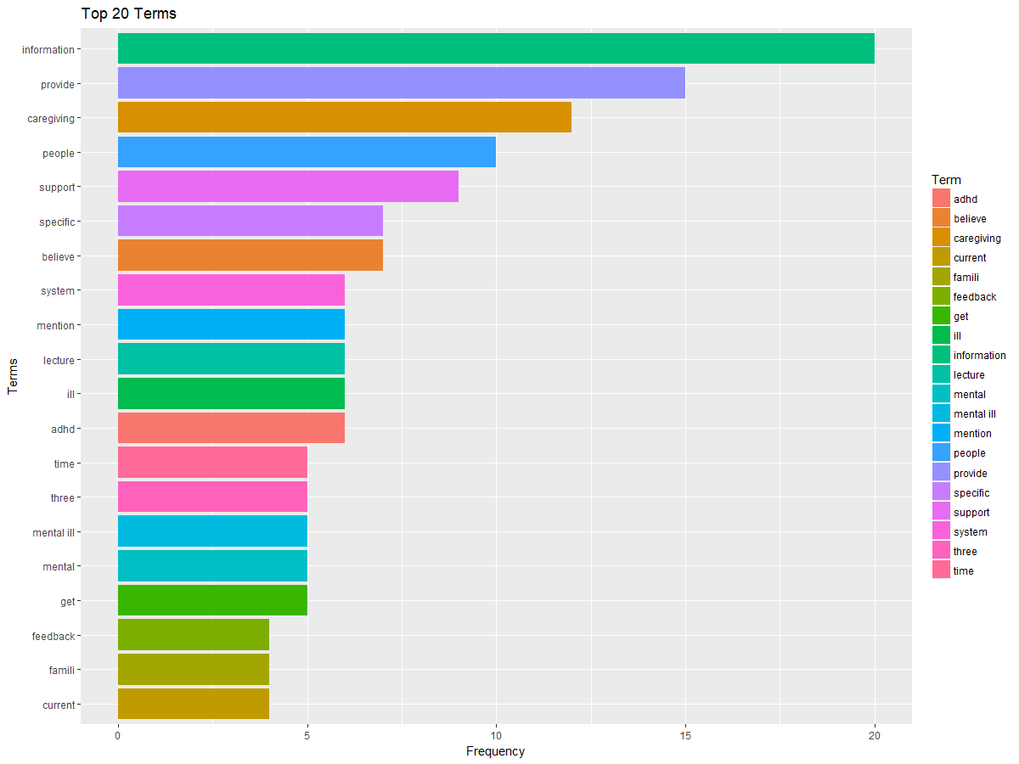
Key Findings – Focus Group Interview – Top 20 Keywords
Provide/ Get information
Specific case
Caring people / family
Want system in place
Story – Police Officer
Worked in Richmond Hill
Attend lecture to understand mental health issue
Train his colleagues
Understand the public he is dealing with

Slide 11
Next Steps Detailed Timeline
Internal Desk Review
Competitive Analysis
Client Interim Report
Board Member Interviews
Client Survey Results
Client Survey
Gap Analysis: Data Synthesis
Recommendations
2018
June 3
Jun 10
Jun 17
Jun 24
July 1
July 8
July 15
July 22
July 29
Competitive Analysis (Future State):
June 17 to June 30
Domestic
June 17
International
June 21
Academic
June 25

Slide 12
Issues Encountered & Wrap-up
Board:
Gaining alignment for the mission and vision from Board members
Frequent turnover of the Board members
Board members functioning as a working Board
Unexpected tragedies causing a ripple effect throughout the organization.
Data:
Between February and May 2018, HOH reduced support programs from running 29 in February to 16 in May
Financial:
HOH wants us to help them apply for a large financial grant from Central LHIN, however this falls under fundraising. The grant application requires a comprehensive strategy however the two are inter-dependent.

Slide 13

Questions, feedback, suggestions

Slide 14
Questions and Feedback
Q1
Do you have any feedback on our project approach? Does the scope match the project definition and is it sufficiently contained?
Q2
Can you suggest a reasonable sample size of survey / interviews to conduct? What are your best practices for driving responses?
Q3
What are some suggestions / recommendations on how to research KPIs and milestones for strategic plans?
Q4
Do you see any other risks? Are there any other considerations we should take in our analysis?

Slide 15

Appendix

Slide 16
Financial Analysis Conducted

Slide 17
Financial Analysis Conducted

Slide 18
Financial Analysis Conducted

Slide 19
SWOT Analysis
Strengths Experienced management team and proficient volunteer team Diverse range of programming catered to improving mental health Flagship Public Education Series on mental health which has access to hundred groups Access to provincial endorsement? Strong Family Support group cohort | Weaknesses Clear misalignment on mission and vision Absence of performance measuring system for overall strategy. Planning for support programs Retaining board members and volunteers Financially relying on the annual Gala for fundraising HOH doesn’t have partnerships with other organizations to increase referrals Group classes are not fully utilized
Opportunities Defining a clear mission to align the organizational resources effectively Partnership with local hospitals for referrals and public visibility/accessibility. New programs to offer e.g. advocacy, increasing frequency of flagship programs, collaborating for supportive housing Proper planning for support programs operations Improve HOH brand in the local community and also politically | Threats Reduced referrals from other organizations Loss of participants to other mental health organizations Potential loss of funding or any regulatory changes Management and Volunteer turnover
SWOT

Slide 20
Next Steps High Level Timeline
Board Member Survey
Competitive analysis, mission and vision review and synthesis will formulate
future state assessment
Internal desk review, Board member survey and client survey will formulate the
current state assessment
Internal Review
Client Survey
Gap Analysis
& Recommendations
Competitive Analysis
Gap analysis will compare current and future states to inform feasible recommendations
Mission Review & Synthesis

Slide 21
Key Findings – Home on the Hill Financials
Collected data from HOH Financial Statements (2012 Apr - 2018 Mar)
Clear organizational shift from 2016 onwards
Heavily driven by Donation and Funding
Introduced revenue stream from operations in 2018

